Slide 1
Panorama Generator
Computer Vision, Winter 2017
Alexander Crawford (100569102)

Slide 2
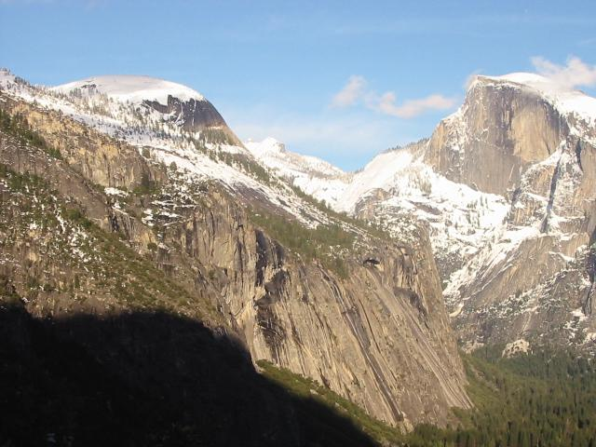
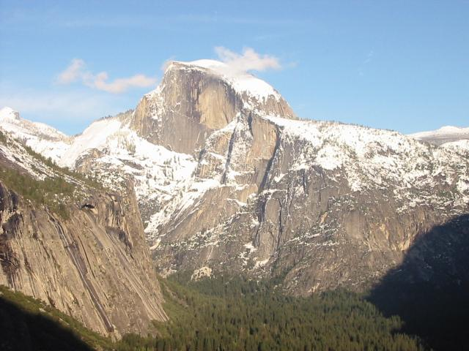
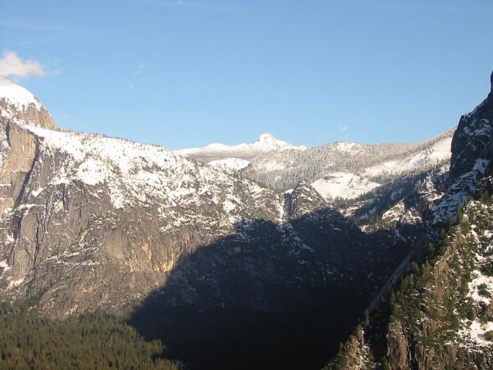
Project Summary
Takes a number of images and generates a panorama
Images can be in (almost) any order

Slide 3
Algorithm
Compare every image via KNN of SIFT keypoints, keeping only ones whose translation is rightward.
Start working from the first image input.
Find the image with the highest correlation.
Add the translation to the translation buffer.
Run concatenated translation on the new image, and concatenate it with the old image.
Repeat from step 3, using the new image, until no more images are found.

Slide 4
Example

Slide 5
Remaining Issues
S l o w
Transformations do not work properly for right-to-left
Propagation of error

